Slide 1
Simulating liquid using the Smoothed-Particle Hydrodynamics (SPH) method
Will An

Slide 2
Demo of this model
SPH model with GPU acceleration (going to talk about this in class): http://xiaodongan.cn/SPH/SPH-9-3.html
SPH model only with CPU (kind of slow): https://www.khanacademy.org/computing/pixar/effects/particle/pi/smoothed-particle-hydrodynamics
Commercial SPH model video with fancy water texture rendered: https://www.youtube.com/watch?v=rscPSudsNwQ&ab_channel=CGFreiburg

Slide 3
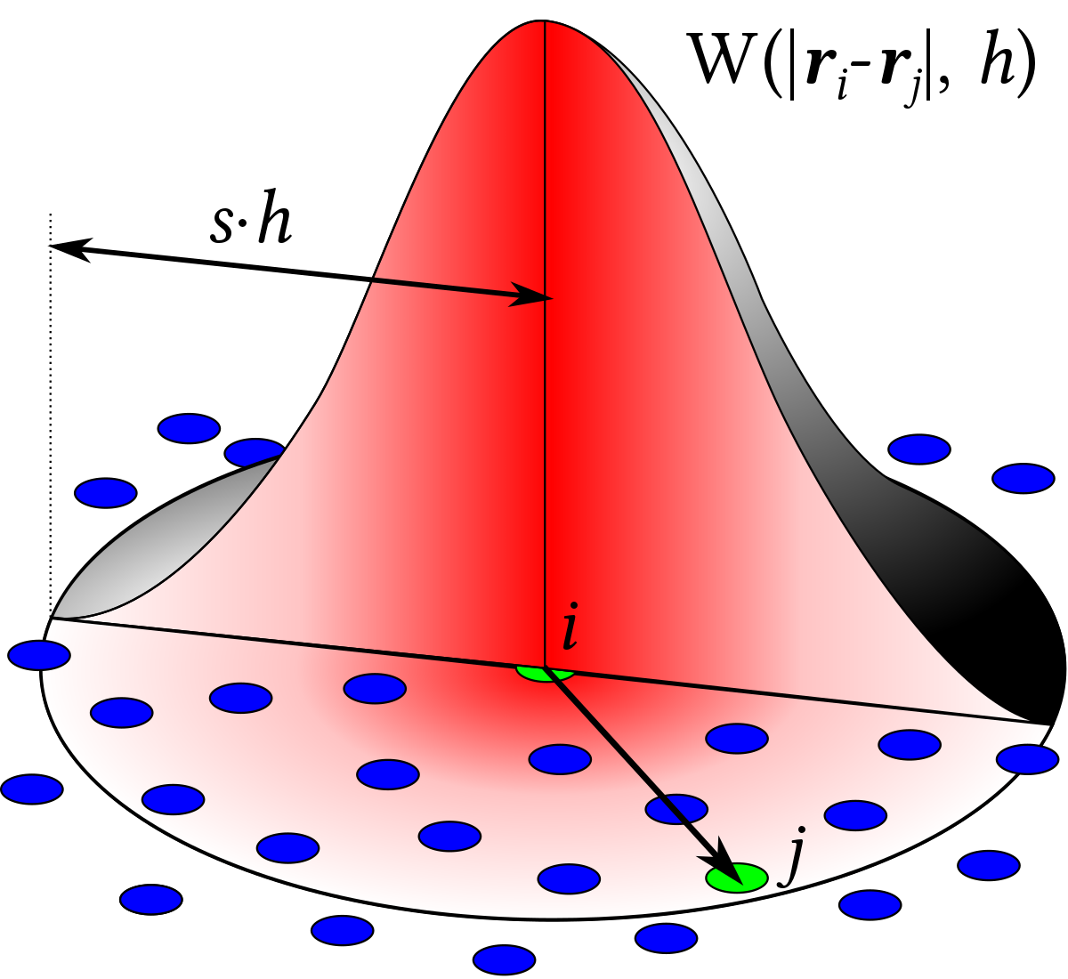

Introduction
A computational method to simulate the dynamics of liquid.
It was first developed in 1977, used to solve the astrophysics problems.
Using a simplified model, with less computing power needed.
It has been used in many fields of research, including astrophysics and biophysics.

Slide 4
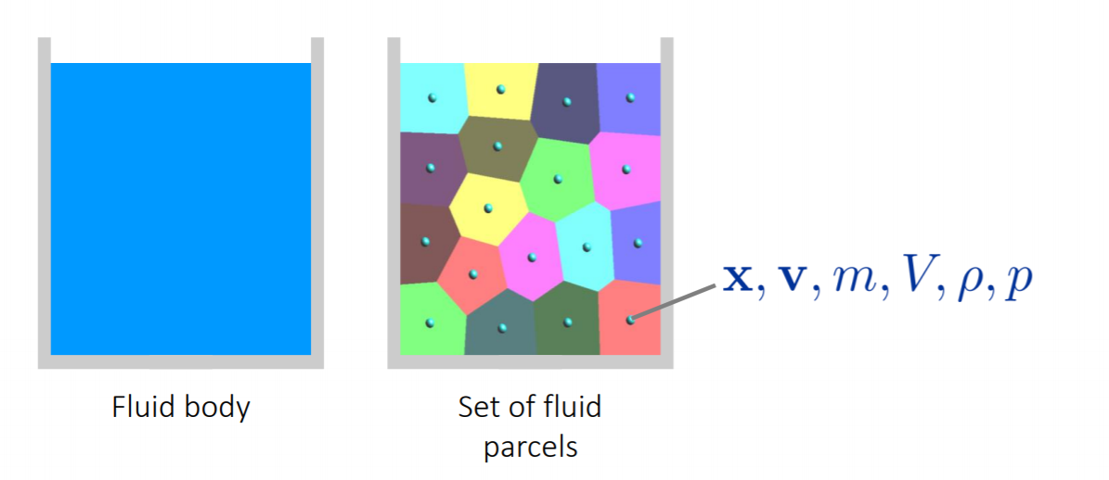
What does SPH mean?
Smoothed means “smoothed circle”, also called Kernel range.
Particle means “made of particles”, this liquid simulation is composed of particles.
Hydrodynamics means “dynamics of water”, hydro = liquid or water, dynamics = moving law for particles.

Slide 5
What does SPH (smoothed) mean?
Smoothed means “smoothed circle”, also called Kernel range, mostly used in Machine Learning.
A method used to increase computing efficiency and decrease CPU calculating time

Slide 6
What does SPH (smoothed) mean?
In liquid, all liquid particles will interact with each other, no matter how far they are.
But to increase efficiency, we do not need very weak interaction (far distance) in actual simulation (they won’t affect final simulation much).
To eliminate those weak interactions, we introduce weighting factor W to represent the relative interacting strength between two particles.
We use h to represent the limit distance (i.e. W = 0) for having interaction, and the circle with radius h is called smoothing circle or kernel range.

Slide 7
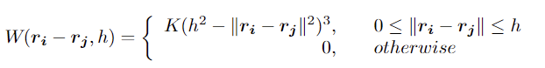
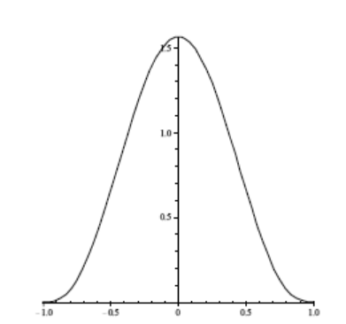
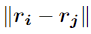
What does SPH (smoothed) mean?
Weight W: Gaussian-like function
K: normalize constant
h: kernel range radius
i,j: particle i and j
: distance between particle i and j
W decreases when interaction distance increases, and will be 0 if outside kernel range h.
W
h

Slide 8
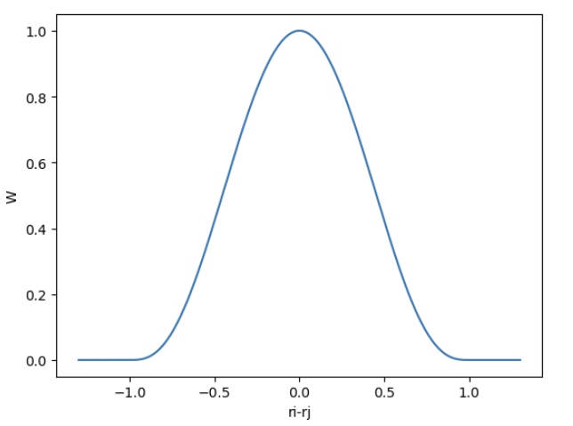
In-Class Problem (10 mins)
Try to draw the function below using python and thus show it is gaussian-like.
Set K = 1, kernel range = 1, ri – rj = r
You get 1 bonus point in your final grade if you volunteer to present your result.

Slide 9
Start simulation of liquid
Initial setup
Solve Navier-Stokes (NS) function (this part is very hard, so you don’t have to fully understand it)

Slide 10
Initial Condition
Fluid is divided into lots of moving particles, with parameters x (position), v (velocity), m (mass), V (volume), ρ (density) and p (pressure).

Slide 11

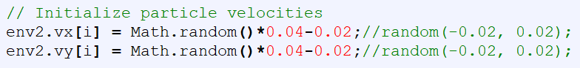
Initial Condition
The divided particles will be assigned to a certain initial positions x, depending on the model you want to simulate. (Height, shape and numbers of particles)
The divided particles will also be given some random initial velocities v. (the value is small, used for later calculation)
Every particle will be given the same mass m.
Every particle will be given the same volume V.
We know
We want to solve

Slide 12
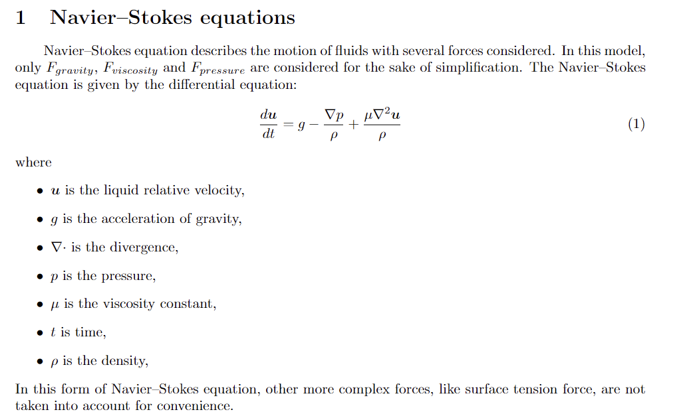
Introduction to Navier-Stokes (NS) function

Slide 13
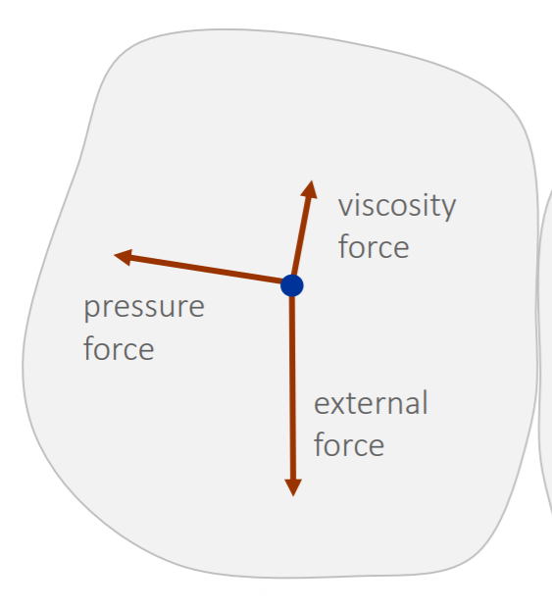
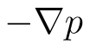
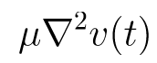
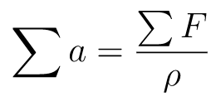
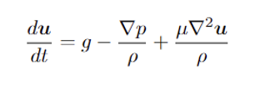
Introduction to Navier-Stokes (NS) function
For each particle, it experiences three forces in this simplified model.
Gravity F: ρ*g (external force)
Here the mass is scaled, and density ρ is used to represent it to reduce unnecessary variables.
Pressure F:
Here pressure force is represented as the derivative of pressure
A pressure constant is needed to scale the pressure F
Viscosity F:
Also known as the friction F.
μ is the Viscosity Constant.
Total Acceleration:
Here u is velocity v

Slide 14
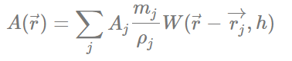
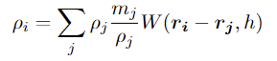
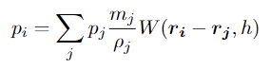
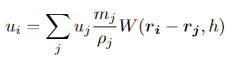
Solve Navier-Stokes (NS) function
Now, to solve velocity v and move the liquid particles, all we need to solve is the acceleration function below
g, μ are constants, and we set initial velocity
So, we need to solve p, ρ
To solve it, we introduce kernel function:
A: the quantity calculated (density ρ and pressure p)
W: Kernel weights

Slide 15
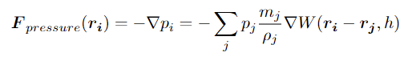
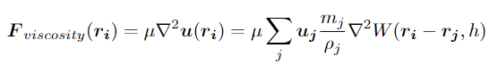
Solve Navier-Stokes (NS) function
To solve it, we introduce kernel function:
A: the quantity calculated (density ρ and pressure p)
W: Kernel weights

Slide 16
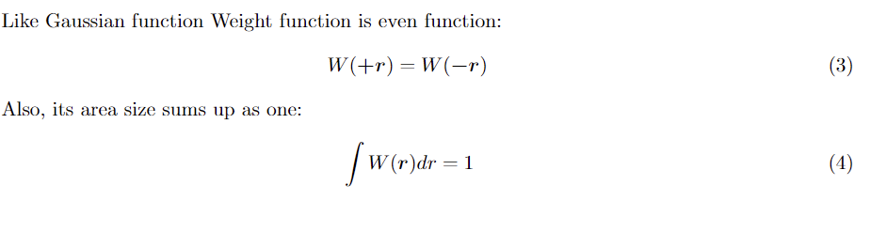
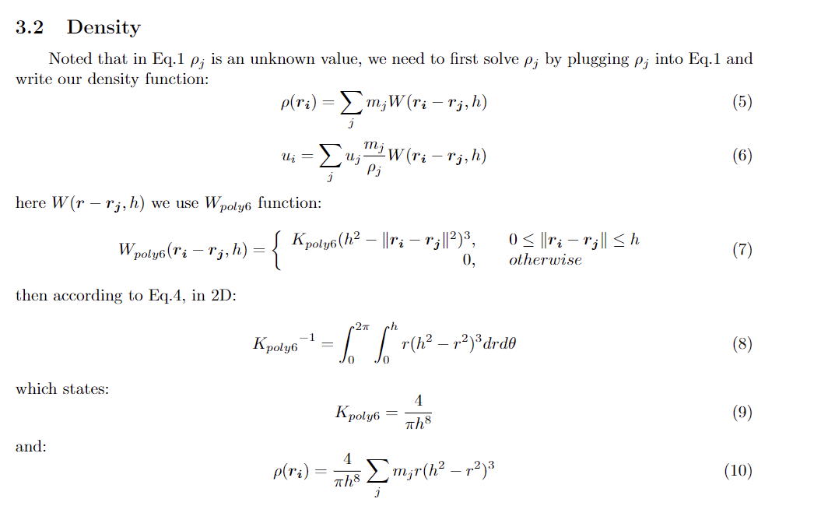
Solve Navier-Stokes (NS) function

Slide 17
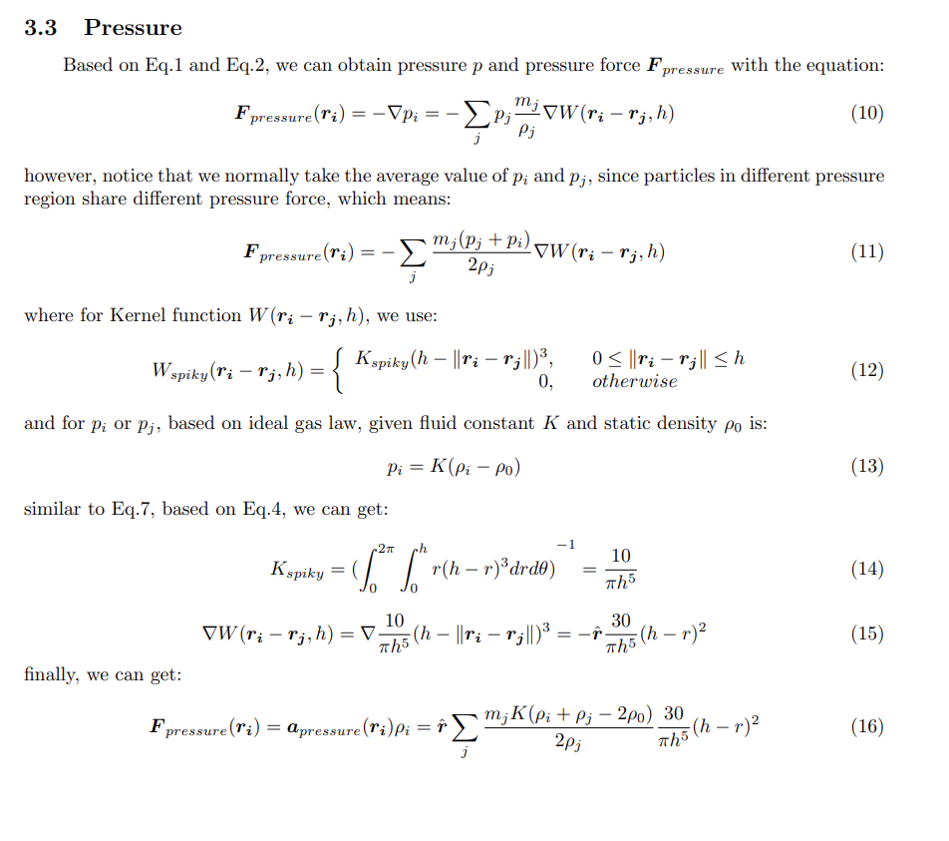
Solve Navier-Stokes (NS) function

Slide 18
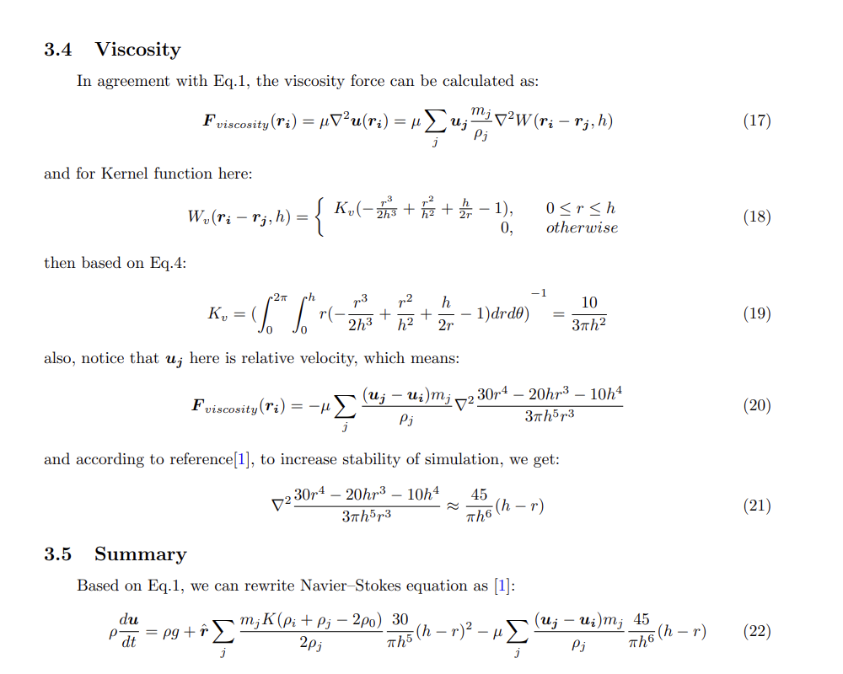
Solve Navier-Stokes (NS) function

Slide 19
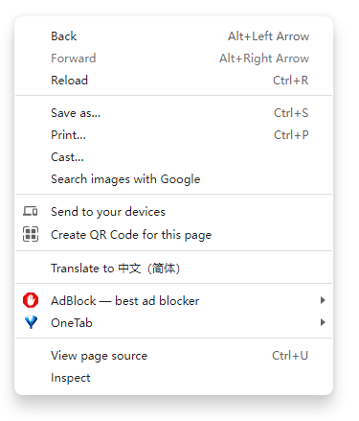
Understanding the code
Now we have solved the NS function, we can start actual coding and simulation.
Open the code here: http://xiaodongan.cn/SPH/SPH-9-3.html
Right click, and choose view page source

Slide 20
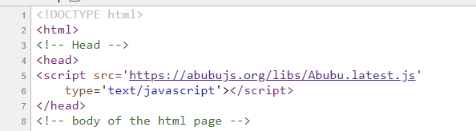
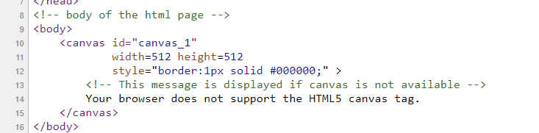
Understanding the code
Line 1 – 7: basic setup for HTML, and introduce Abubu.js library, which is a library to apply GPU coding.
Line 9 – 16: it creates body in HTML file, which is a canvas for us to paint simulation on.

Slide 21
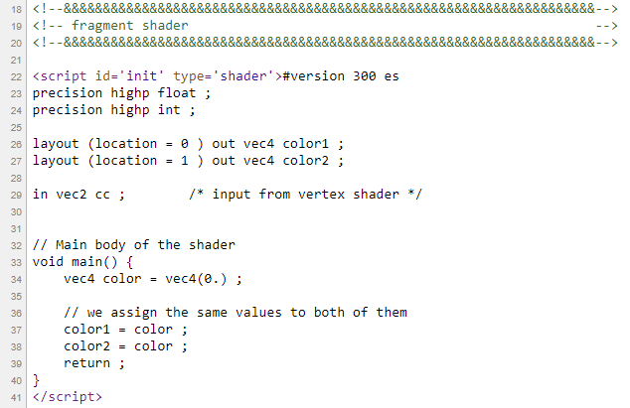
Understanding the code
Line 18 – 86: place (shader) for GPU coding, basically it directs GPU to either calculate or draw something on the canvas.
This shader called ‘init’, used to provide initial color, will be used in next shader.

Slide 22
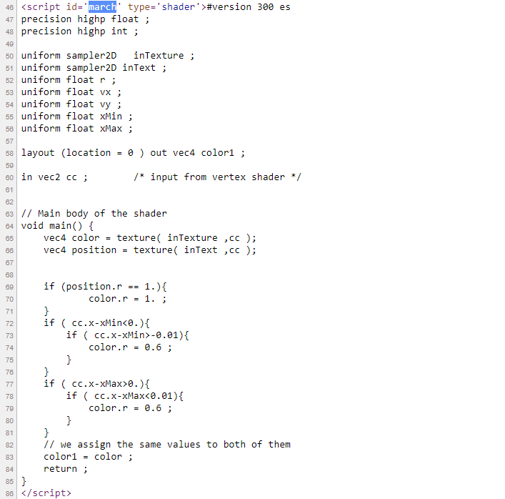

Understanding the code
Line 18 – 86: place (shader) for GPU coding, basically it directs GPU to either calculate or draw something on the canvas.
This shader called ‘march’, used to draw every frame of simulation (blue background, particles and walls)

Slide 23
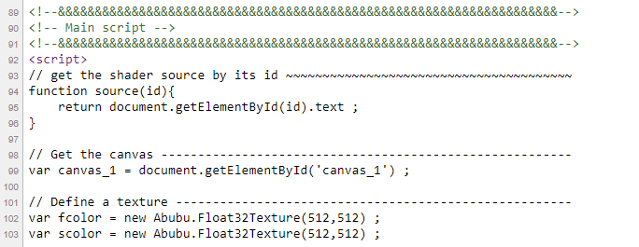
Understanding the code
Line 86 - : now we finish GPU coding, then we start CPU part (in JS), which means from now on, main calculation will be done by CPU.
Common setup
Define texture for us to do calculations on it, and to transform data from CPU side to GPU side.

Slide 24
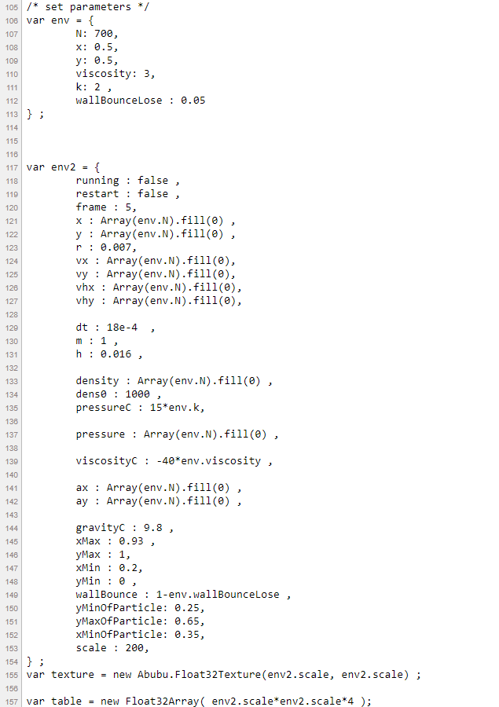
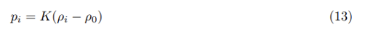
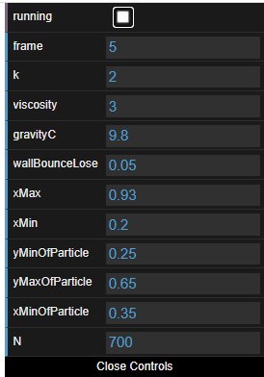
Understanding the code
Line 105 – 154: set parameters.
env.N: particle numbers
env.viscosity: μ
env.k: K
env.wallBounceLose: 0.05 means particle lose 5% Kinetic E when hitting the wall.
env2.running: start simulation if true.
env2.frame: how many frames we calculate per time, smaller this value, higher the frame rate.
env2.r: radius of particle.
env2.h: kernel range/smoothing circle radius
W
h

Slide 25
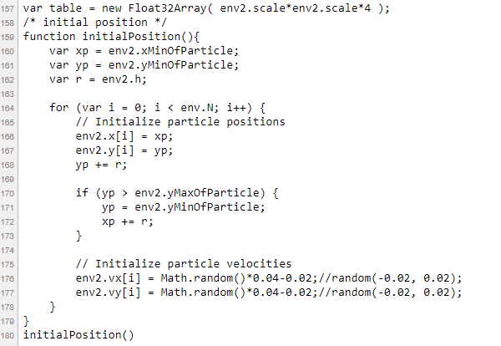

Understanding the code
Line 157 – 180: setup for initial positions and velocities of particles.

Slide 26
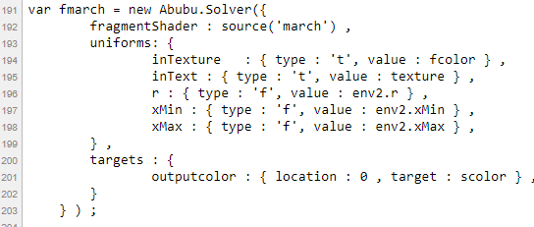
Understanding the code
Line 182 – 253: setup for the data transformations between GPU and CPU, in the format of texture.
For example, below it sends uniforms from CPU to GPU and receives targets from GPU to CPU.

Slide 27
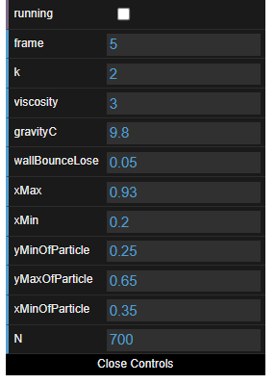
Understanding the code
Line 254 – 352: GUI (Graphics User Interface) setup.

Slide 28
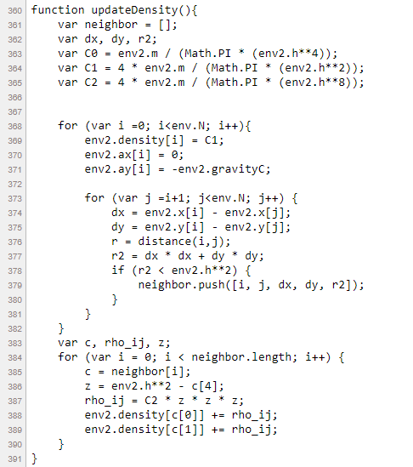
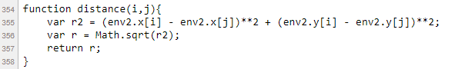
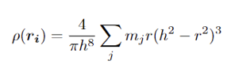
Understanding the code
Line 353 – 515: Actual calculation of SPH.
Function for |ri - rj|
Calculate Density ρ
Kernel range/ Smoothing circle radius

Slide 29
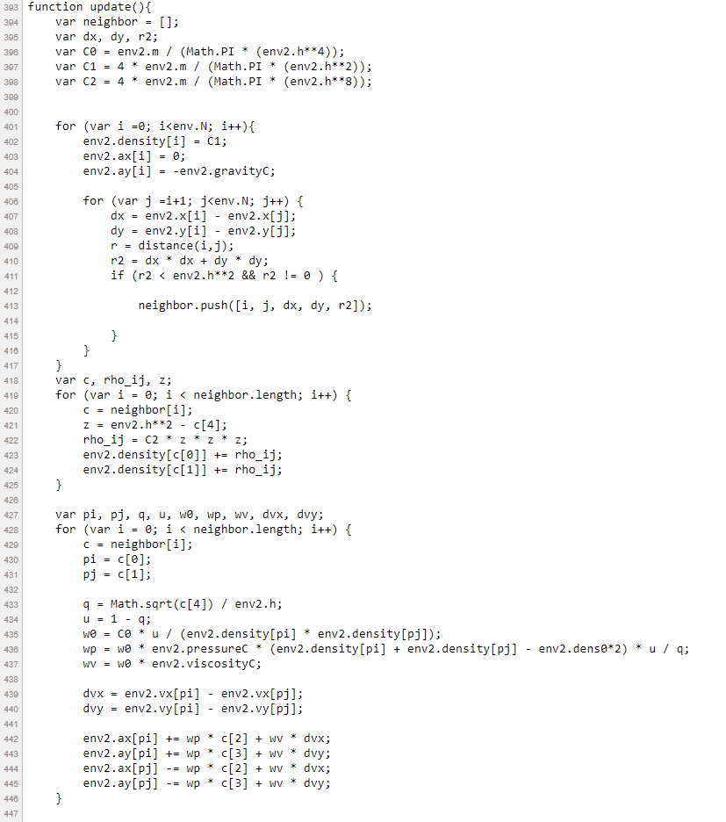
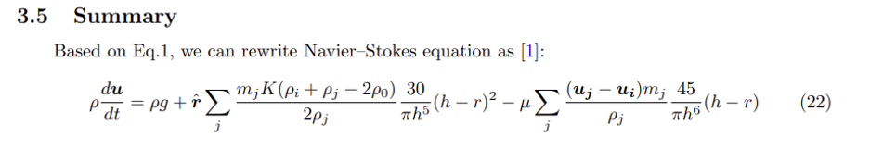
Understanding the code
Line 393 – 446: Solve NS function.

Slide 30
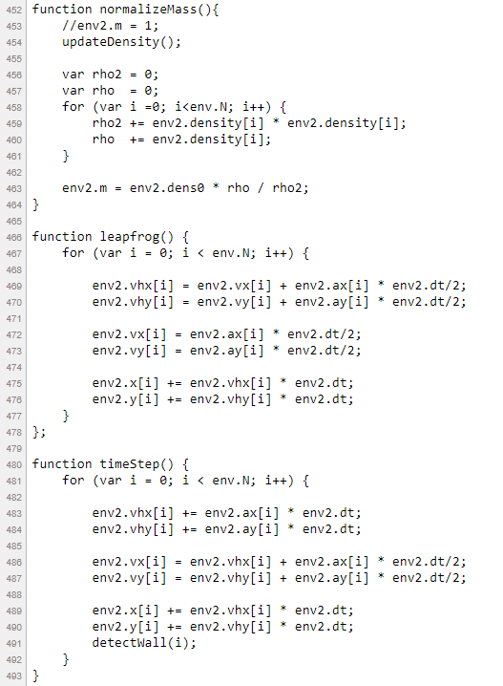
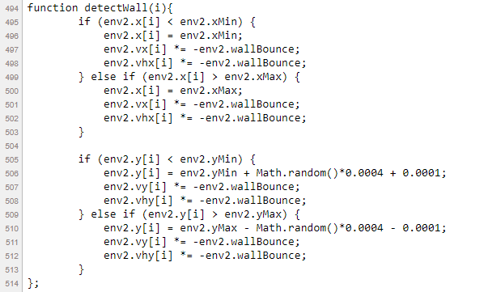
Understanding the code
Line 452-514
normalizeMass: normalize Mass based on ρ0.
leapfrog: An integration method to decrease error.
timeStep: run the simulation.
detectWall: particle lose energy and change direction when hit wall.

Slide 31
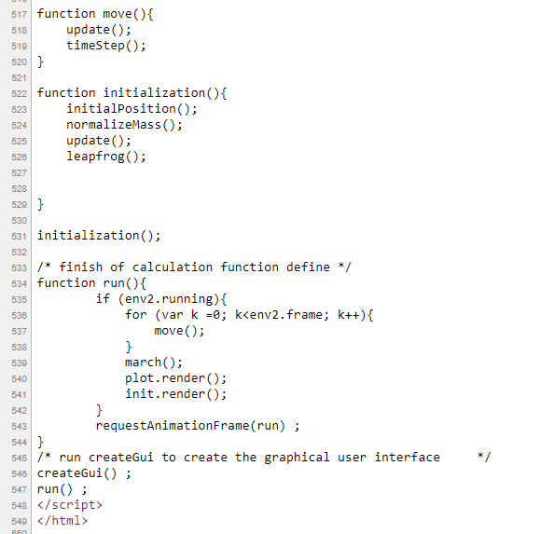
Understanding the code
Line 515-550: common codes to move forward frames (animations)

Slide 32
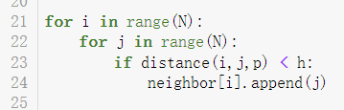
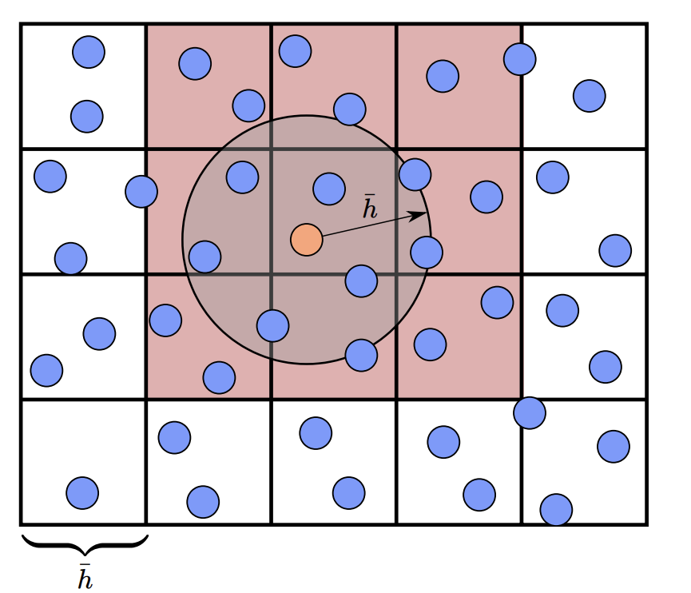
Grid-based Neighborhood Search
In this model, we need to find neighbors of particle i within distance h.
In python, usual way to do it is to use double for loops.
This method will check distance for N*N times, which is quite slow.
Now, we introduce Grid-based Neighborhood Search method.

Slide 33
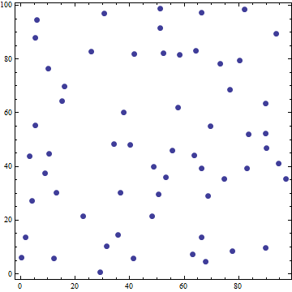
In-Class Problem (10 mins)
Try to modify the code in file NeighborSearch.py
Show that Grid-based Neighbor search is much faster than common search.
You get 1 bonus point in your final grade if you volunteer to present your result.
We create N = 2000 particles randomly located in a 100*100 map
Try to find neighbors (within radius = h circle) for each of them
Store their neighbors in a list
h

Slide 34
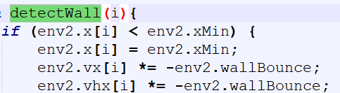
Basic Algorithms – Adding Obstacles
Once the position of particle goes beyond the Boundary, we make the position back to the Boundary in next time step and multiples the velocity a Bouncing Constant (some energy loss).
Basic idea for a moving Block is to create a moving Boundary and Visualize it.

Slide 35
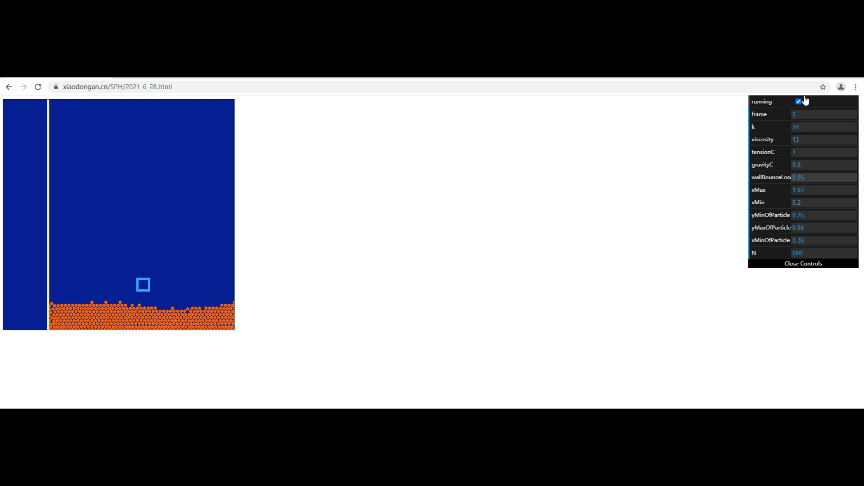
Basic Algorithms – Obstacles Demo

Slide 36
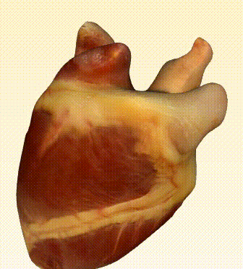
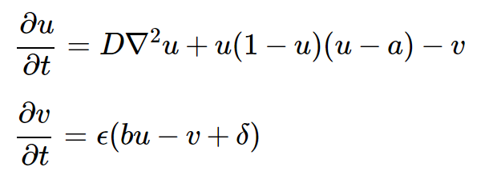
Application in Heart Model
The SPH method can be used to simulate the Blood in Heart.
By applying the FHN (FitzHugh-Nagumo) equations we can get the elastic deformation of heart.
By using the movable Boundary Conditions, a heart model with Blood can be visualized.
FitzHugh-Nagumo Equations
u: Membrane voltage
v: Gating voltage

